Slide 1
Supervised Learning: Overview II
Rayid Ghani
Slides liberally borrowed and customized from lots of excellent online sources

Slide 2
Types of Learning
Unsupervised
“Weakly” supervised
Fully supervised
Clustering
PCA
…
Anomaly Detection
Classification
Binary, multi-class, hierarchical, sequential
Regression

Slide 3
Supervised learning framework
y = f(x)
Training: given a training set of labeled examples {(x₁,y₁), …, (x_{N},y_{N})}, estimate the prediction function f that minimizes future generalization error
Testing: apply f to a new test example x and output the predicted value y = f(x)
features/variables/inputs/predictors/independent variables
Output / dependent
variable
Learned
function

Slide 4
Methods
Nearest neighbor
Decision Trees
Logistic Regression
Support Vector Machines
Bayes Classifier
Ensembles
Bagging
Boosting
Random Forests
Neural Networks
We’ll cover these two in class today

Slide 5
What we covered last class
Nearest Neighbor
Decision Trees

Slide 6
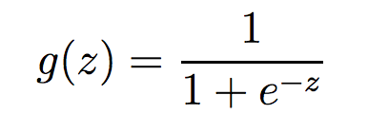
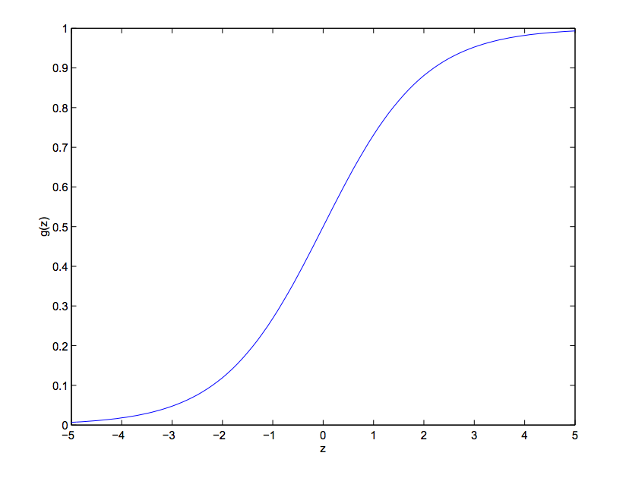
Logistic Regression
Maps x to a 0-1 space.

Slide 7
Logistic Regression
Probability P
Odds P / (1– P)
Log Odds Log (P/ (1– P))
Log P/(1-P) = a + bX
P/(1-P) = e^{(a+bX)}
P = e^{(a+bX)} / (1 + e^{(a+bX)}) or 1/(1+ e^{-(a+bX)})

Slide 8
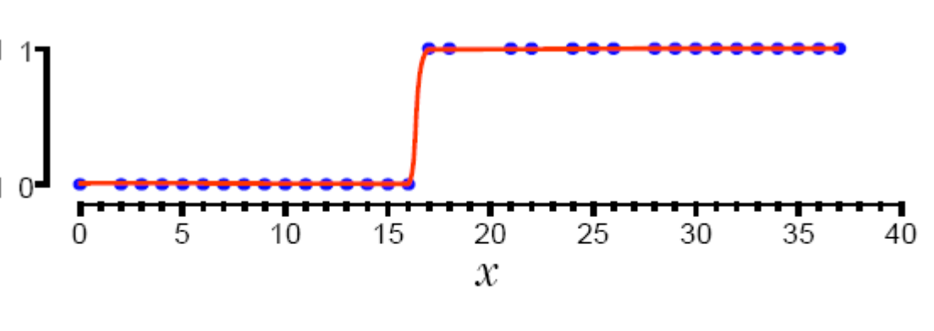
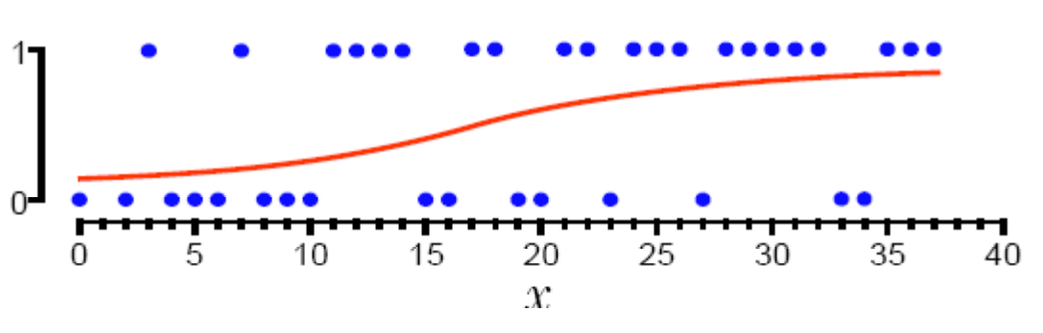
1-Dimensional Decision Boundary

Slide 9
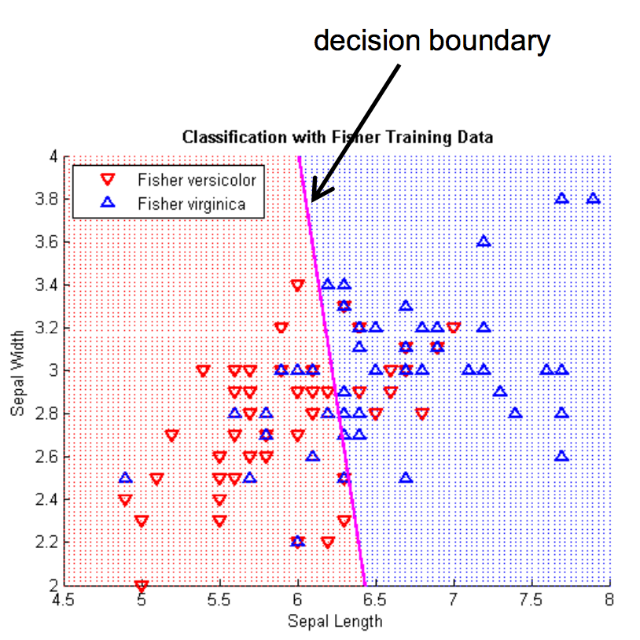
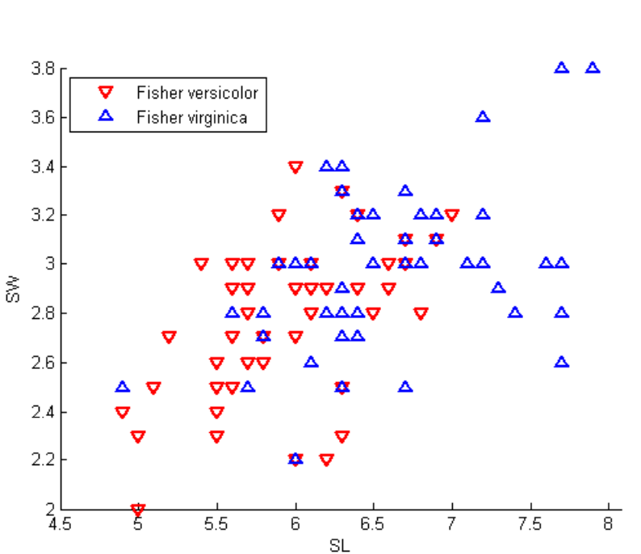
2-D Decision Boundary

Slide 10
More about Logistic Regression
http://nbviewer.jupyter.org/github/justmarkham/DAT8/blob/master/notebooks/12_logistic_regression.ipynb
Little deeper into Logistic Regression https://www.youtube.com/watch?v=31Q5FGRnxt4&list=PL5-da3qGB5IC4vaDba5ClatUmFppXLAhE
Visualization: https://florianhartl.com/logistic-regression-geometric-intuition.html

Slide 11
Linear Classifiers

Slide 12
Which is the “best” separator?

Slide 13
ρ
r

Slide 14
w^{T}x + b = 0
w^{T}x + b > 0
w^{T}x + b < 0
y = f(x) = sign(w^{T}x + b)

Slide 15
Linear SVMs Mathematically
Then we can formulate the quadratic optimization problem:
Which can be reformulated as:
Find w and b such that
is maximized
and for all (x_{i}, y_{i}), i=1..n : y_{i}(w^{T}x_{i} + b) ≥ 1
Find w and b such that
Φ(w) = ||w||²=w^{T}w is minimized
and for all (x_{i}, y_{i}), i=1..n : y_{i} (w^{T}x_{i} + b) ≥ 1

Slide 16
Nonlinear SVMs
Datasets that are linearly separable work out great:
But what if the dataset is just too hard?
We can map it to a higher-dimensional space:
0
x
0
x
x²
0
x

Slide 17
Logit vs Linear SVMs
Logistic regression maximizes the conditional likelihood of the training data
Linear SVM maximizes the margin

Slide 18
Using SVMs
Kernel: Linear, Polynomial, RBF
Normalizing features
Other Parameters
C: penalty for errors
No Probability estimates

Slide 19
Probabilistic Classifiers
We want to estimate P(class | data) for every class (and often pick the class with the max p( class | data)

Slide 20
Bayes’ Rule
For a data point d and a class c

Slide 21
Naïve Bayes Classifier
MAP is “maximum a posteriori” = most likely class
Bayes Rule
Dropping the denominator

Slide 22
Naïve Bayes Classifier
Data point d represented as features x1..xn

Slide 23
Naïve Bayes Classifier
O(|X|^{n}•|C|) parameters
How often does this class occur?
Could only be estimated if a very, very large number of training examples was available.
We can just count the relative frequencies in a data set

Slide 24
Naïve Bayes - Independence Assumptions
Conditional Independence: Assume the feature probabilities P(x_{i}|c_{j}) are independent given the class c.

Slide 25
Naïve Bayes Classifier

Slide 26
Naïve Bayes Example

Slide 27
Pros and Cons
Pros
Fast
No need to fill in missing data
Explicitly handles class priors
Incrementally updated
Cons
Independence assumption may be violated in practice (Features are correlated)
Gives skewed probability estimates when # of features is large. Why?

Slide 28
Questions to think about
When would Naïve Bayes fail?
How would you relax some of the assumptions behind naïve bayes to make it more robust?

